Slide 1

Debt Free!
Luke 7:36-50

Slide 2

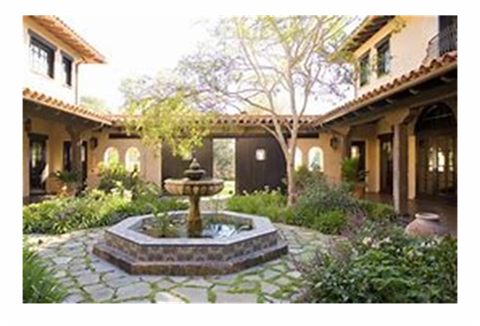
Debt Free! Luke 7:36-50
The Invitation

Slide 3
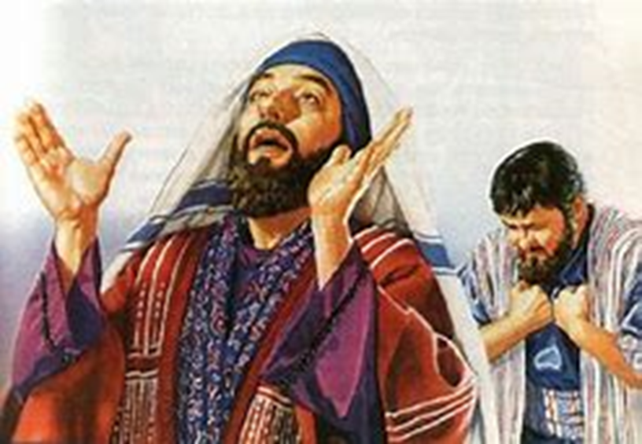
Debt Free! Luke 7:36-50
Religion without Faith

Slide 4
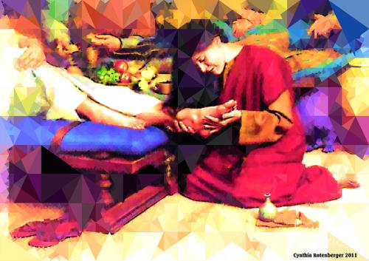
Debt Free! Luke 7:36-50
Gratitude without Reserve

Slide 5

Debt Free! Luke 7:36-50
Life without Debt

Slide 6
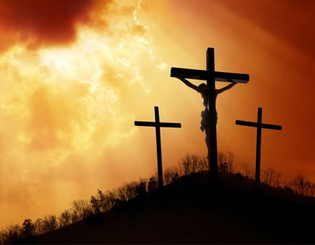
Debt Free! Luke 7:36-50
Who is this Man?

