Slide 1
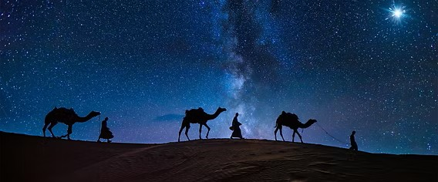
The wisdom of seeking Jesus

Slide 2
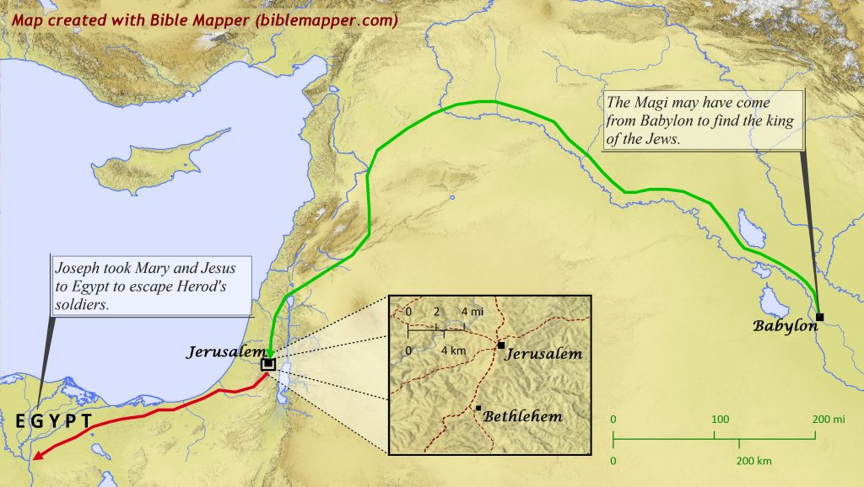

Slide 3


Slide 4
What about these wise men?
1. Their journey was one of FAITH
2. Their journey was of WORSHIP
3. Their journey involved SACRIFICE
4. Their journey brought CHANGE

Slide 5
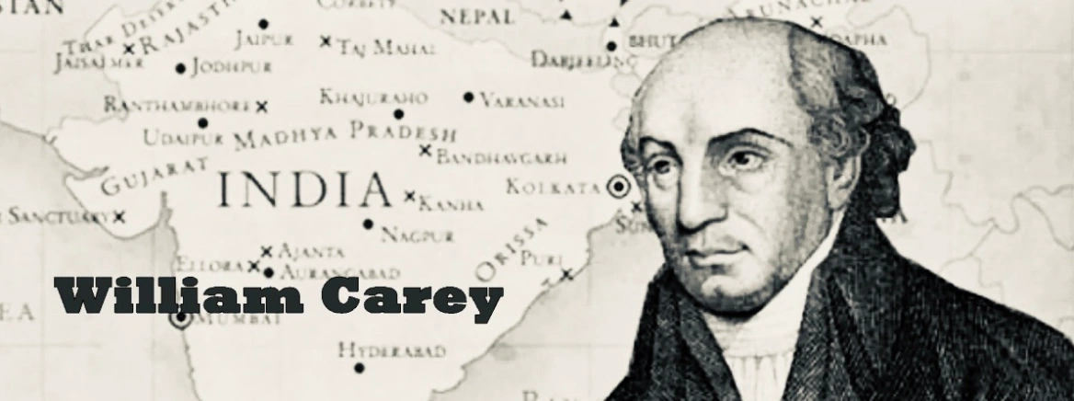

Slide 6


Slide 7
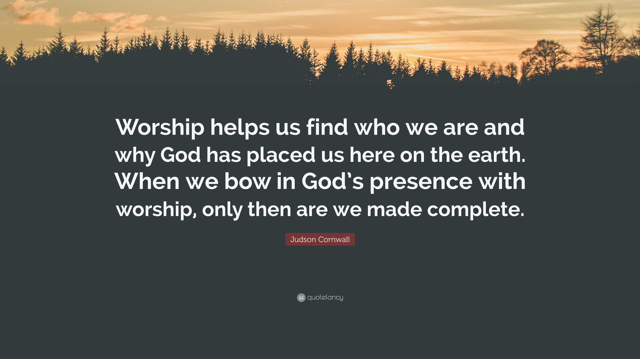

Slide 8


Slide 9
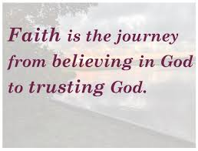

Slide 10


Slide 11
